Slide 1
Final Project
World Wide Web Design
Web 121A
Timothy Daniels

Slide 2


TLD & Associates
Manufacturer’s Representative
To Assist Manufacturers In
Market Effectiveness
Networking
Selling products to clients who want buy

Slide 3
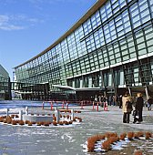
Located In Southern California
Product List Include
Textiles
Toys
Home Improvement
VoIP
Employee Referrals

Slide 4

Product Line are
Made In The USA
With
Trading Partners:
Hong Kong, China; India
Germany, Canada

Slide 5

TLD & Associates
+
Client + Manufacturers = one
Market Positioning :
Internet, Blogs; Webinars,
Trade Associations
Media Outlets
Improving :
Manufacturer’s Visibility
And

Slide 6

Cash flow
Manufacturer
QVC Teams
Shippers
Consignee and
Ultimate customer

Slide 7
Thank You
Inspire Yourself To Go More
Timothy L Daniels
Manager:
TLD & Associates

